Slide 1
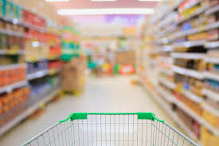




Establishments in this industry retail general lines of food products, including fresh and prepared meats, poultry and seafood, canned and frozen foods, fresh fruits and vegetables and various dairy products. Delicatessens primarily retailing food are also included (IBIS Report) [1]
ERM in the Supermarket and Grocery Industry: What can we learn?
Presented By:-
Anupama Mohan Rao
Margaret Avril Bell Houston
Sarang Sanjay Bakshi
Shubham Gunwant Shete

Slide 2
Agenda
Why a research project ?
Research Methods and Keywords
Introduction to the industry
Risk assessment technique
Top Risk with current events
Business Contingency Plan
Disaster Recovery Plan
Reflection and Recommendation
Lessons Learned

Slide 3
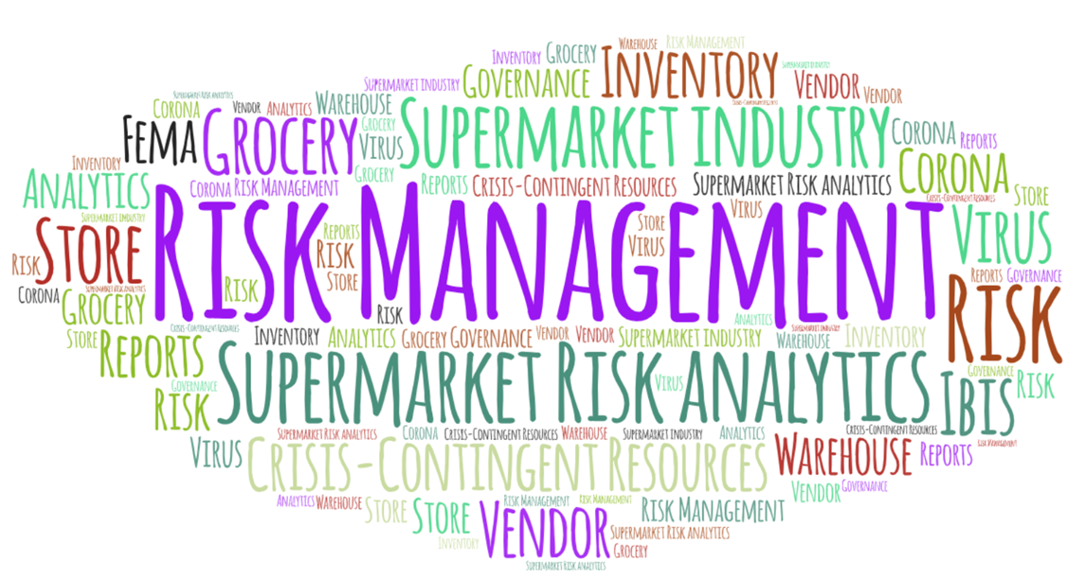
Research Methods
Archival Research using SU Subscription Databases
ABI/INFORM Collective
Academic OneFile
Access World News
Access Science
IBIS reports
Key Words
Grocery store(s)
Grocery store risk governance
"grocery store" (risk AND (governance OR management OR recovery))
"grocery store" coronavirus
Vendor Management Inventory
Warehouse Management
Crisis-contingent resources
FEMA
Supermarket industry
Supermarket risk analytics

Slide 4
Introduction to the Industry
Facts about the Industry:-
Employees 4.8 million people [2]
38,307 number of super markets [3]
Known by many names
NAICS Code- 445110
Top 5 companies occupy 60% market share [4]
Essential difference between Supermarket and small Grocery stores is their ERM structure.
History & Evolution of the Industry
19th Century- Streets would be lined with “greengrocers” (for produce), dairy shops, butchers, fishmongers and grocers that exclusively sold dry, packaged goods like canned food
1916- First ever self-service grocery store 'Piggly Wiggly' introduced by Clarance Saunders
1950's- Golden age of supermarkets in USA.
1962- First Walmart opened in Arkansas [5]
Notes:
Also known by the names such as
Convenience stores
Supermarket
Mom and Pop store
Bodega
Corner store
Food Mart
Food Store
Market
Retail food store [6]
Difference between a Supermarket and a Grocery store.
Size (Supermarkets are much Larger)
Supermarkets have bigger inventories than small grocery stores
The profit margin for supermarkets is usually very small and the discounts are forwarded to the customers
Supermarkets could be a part of a Franchisee or a Chain.
In terms of risk management a supermarket follows a standardized format whereas a grocery store doesn’t [7]
The acronym NAICS is an abbreviation of the North American Industry Classification System. This system is the standard used by federal statistical agencies for classifying businesses for the purpose of collecting, analyzing, and publishing data related to the U.S. economy
Top 5 companies namely Walmart, Costco, Kroger, Safeway, Supervalu occupy 60% market share.
This demonstrates the evolution of the grocery industry and its transition over the years from an open market scattered over a huge area with individual sellers for individual products to a consolidated market selling all the products under one roof.

Slide 5
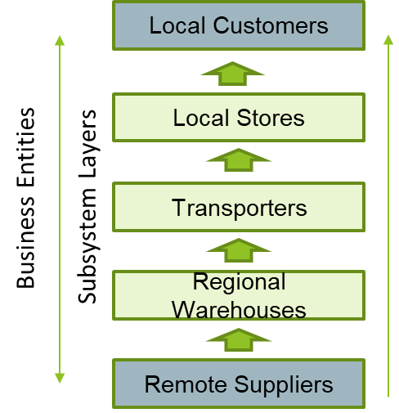
How does a Supermarket Industry functions?
Buying Functions
Finding Suppliers
Placing Orders
Stocking goods
Taking inventory
Viewing showrooms
Selling Function
Maintaining a clean store
Pricing of goods
Selling of goods
Advertising for the goods
Controlling Function
Cashiering
Keeping records
Paying Bills
Security
Bank deposits
[8]
Notes:
The above flow charts explains how does a supermarket functions as well as different categories in which a supermarket industry is divided into such as the buying function, the selling function as well the controlling function in the supermarket industry. This will then further help in explaining the traditional risks faced by the supermarket industry.

Slide 6
Heat map for identified risks
Fatal | Pandemic | Failure to comply with laws and regulations | Supply chain failure
Severe |  |  | Accidents | Improper storage of goods
Major |  | Intense competition |  | Online shopping
Significant |  |  |  | Indirect Theft
Moderate
Minor |  | Reputation risks | Decline in customer spending | Perishable food wastage
Insignificant |  |  | Direct theft
 | Almost never | Rarely | Sometimes | Often | Always/very frequent
Impact
Frequency
Notes:
We identified risks that were common across organizations and created a heatmap, showing least likely-least impact and most likely-most impact and everything in between.

Slide 7
Risk identification and measurement
Risk | Risk Measurement strategy | Risk Management strategy
Reputation Risks | Customer dissatisfaction; magnifies the effect through social media | Conduct customer satisfaction surveys, customer relation management system, policies for dealing with social media comments, provides proper training to employees.
Intense competition | Obstruct revenue growth, competition through product price reduction. | Risk transferring: loyalty cards. Product pricing strategy by understand customer behavior.
Supply chain failure | Shortage of goods to fill the shelves hinders day-to-day operations. | Have 2-3 suppliers, use the power of AI in Demand forecasting, stock management policy.
Decline in customer spending | Measuring cash flows | Risk mitigation: Monitoring daily sales to see change in trend/pattern.
Notes:
Top three categories of consumer spending: food(13%),Housing and household operation(33%),Transportation(19%). 2/3rd of the consumer spending comes from supermarkets.
Some retail chains such as Walmart have a bad reputation for driving out local businesses and facing nearly 5000 lawsuits every year.

Slide 8
Risk identification and measurement(Contd.)
Risk | Risk Measurement strategy | Risk Management strategy
Online shopping | Reducing number of walk-in customers. | Website displaying promotion and sales, creative ways to encourage customers to make in-store purchases.
Failure to comply with laws and regulations | Temporary/permanent closure of stores, financial losses and/or penalties. | Risk mitigation: identify and comply with changes made to laws and regulations, taking timely action to renew contracts.
Fraud and theft | Indirect thefts: pay using counterfeit money, exploit discounts, sell products for a cheap price Direct thefts: Stealing goods | Use money counting and counterfeit detection equipment, implement strict policies on employee discounts, heavy security near goods storage, insure goods against theft (Risk transfer)
Improper storage of goods[6] | Accidents, perishable food wastage, insects/worms, fire, natural disasters | Risk transferring: insure goods against fire, better storage procedures that are reviewed periodically.
Notes:
48% of US grocery shoppers buy at least some of their groceries online.
58% of self-checkout shoplifters defined stealing from a self-checkout machine as easy. 20 percent of known shoplifters visited three or more locations of the same retail chain.

Slide 9
Top risks: Covid-19 impacts
Decline in customer spending
Consumers are worried about entering stores to make purchases. About 76% of Americans are changing their shopping habits, purchasing only essentials such as food, water, toiletries, cleaning supplies and pet supplies.
Companies such as Instacart are facing huge demands like never before and they are unable to cope up with the demand.
There’s a lot of competition between major retailers in terms of stockpiling, prices. Not only that there is competition between in-store shopping and digital shopping.
Outlets are taking extra precautions while entering stores.
Companies are taking up social media platforms to address these issues.
Stores and supermarket franchises are trying to maintain a safe prices that would still profit them.
Reputation Risks
Intense Competition
Notes:
Retail giants such as Walmart and Costco are limiting the number of people entering the stores at a time.
Price of groceries and essentials in Wegman’s, Target, Walmart remains more or less the same.

Slide 10
Covid-19 impacts(Contd)
Online shopping
Due to the nature of the current pandemic, consumers are afraid to step into the store physically to make purchases and are switching to online shopping.
Most of the industries are at a standstill, travel restrictions imposed due which many shelves in most of the stores are empty.
Stores are making some purchases for ”in-store” or “pickup” facilities only. Stores are also making stricter rules to keep the front-line employees safe as well as the customers.
Purchase restrictions on the quantity, especially for essential items such as hand sanitizer, disinfectant, toilet paper rolls has been imposed.
Supply Chain Failure
Notes:
About 60% of the people say that they will continue online shopping once the pandemic ends.

Slide 11
Pandemic Risk Management
Give all employees paid leave if they have any reason to suspect illness
Keep as much cash on hand as is feasible in case of closures
Determine how many people can fit inside the store while keeping six feet apart from each other, and strictly limit the number of shoppers to that.
Sanitize regularly everything that multiple people must touch, such as shopping carts
Provide cloth masks to all employees and wash them between shifts
Encourage customers to use cards instead of cash
Trade on high levels of unemployment to be generous in acquiring new employees
Notes:
Grocery stores face enormous risk during a pandemic like this, but also enormous opportunity. Grocery stores stay open when everyone else is closing, because people need groceries and starving isn’t better than getting sick. As a result, while managing negative risk is of course enormously important, not overreacting or failing to take advantage is critical. If you don’t already have a pickup or delivery service, start one. Clean everything and make sure people know it. Hire people left out of work by the closure of less critical business and take advantage of perks like free government childcare for grocery store workers during the coronavirus.

Slide 12
Business Contingency Plan
FOOD INDUSTRY GIANTS
Securing safe and alternative supply of raw materials and key ingredients from suppliers
Identification of a potential disasters
Periodic replenishment of perishable food products
Speedy delivery options as a competition to online products
Warehouse Management
Equipping the store with a security camera
Basic defense training to the Cashiers and staff
Slip and Fall Lawsuit
Insurance is the Key
SMALL GROCERY STORES
Identify local suppliers and work in partnership
Considerations: • Lost sales and income • Negative cash flow resulting from delayed sales or income • Increased expenses (e.g., overtime labor, outsourcing, expediting costs, etc.) • Regulatory fines • Contractual penalties or loss of contractual bonuses [11]
Identify the point in time when the disruption would have greater impact
Identify the duration of the interruption or point in time when the operational and or financial impact(s)
Prepare to seek financial assistance from the government ( FEMA)
Notes:
Securing of food stocks is important to determine and evaluate the potential effects on the Business, which is considered during the business Impact Analysis.
Stepping Up and Cost management is essential to understand that there is an alarming rate at which a potential disaster might ruin the Business
Understanding the market risk and taking appropriate measures to ensure customer retention
Adapting to an alternative Business Function
Questions on ethicality ; amidst the crisis if there is theft or operational fraud.
a contingency plan has the potential to reduce your losses which provides beneficial information while negotiating about insurance costs.

Slide 13
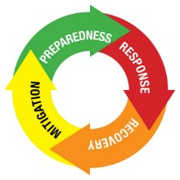
Disaster Recovery
Incident Response: Ground rule is to work and plan towards resilience from day 1 ​
Owner and stakeholders, the first responders must
Communication with Stakeholders/Suppliers/Consumers
Selling of perishable food items at a lower profit margin
Extended operational hours to cater more and more consumers
Implementation of Vendor Management Inventory Technique​
Seek help from government programs like FEMA’s small business administration program [13 ]
Sell what you can !
Notes:
1. Communication is essential aspect while considering a small grocery store. Communication between the employer, employees and customers.
2. Prioritizing the issues that are most important in the emergency response period
3. Prepare a to-do list and start work towards it to improve the conditions
4. Implementation of alternative Plans to keep the business operational
5. Responding to the ad-hoc requests on a daily basis

Slide 14
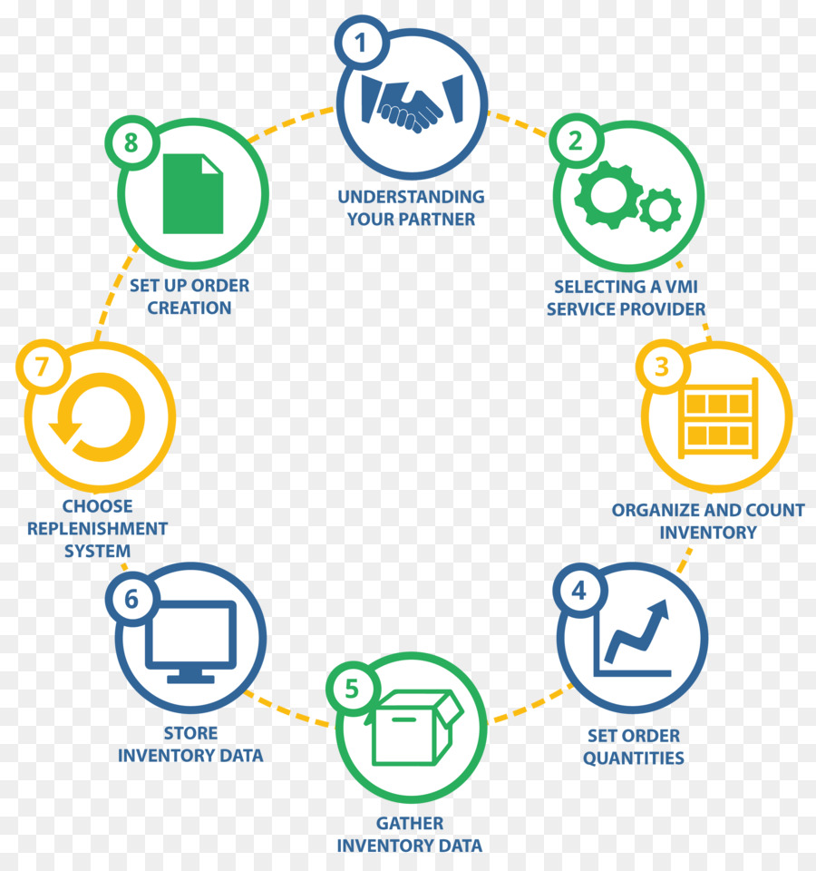
Lesson Learned : Reflection and Recommendation VENDOR MANAGED INVENTORY SYSTEM
Direct relation between the buyer and vendor
The vendor maintains a stocked warehouse based on the Buyer’s need near the consumption location
A third-party logistics provider can supply required level of Inventory
Reduced purchasing costs for the buyers
Reduced costs for the Vendor as the lower inventories management will reduce the need of warehouse resources and space
Source: CleanPng
Notes:
Benefits:
Vendors can leverage from the data of the customers as they have the customer’s point of sale for better forecasting
As a manufacturer has more visibility to their customer inventory levels, it is easier to ensure that stock-out will not occur.
Assuming your vendors are managing your inventory in an optimized fashion - you should always have stock on hand. And will be able to ship on time.
Reduced cost for everyone in the partnership

Slide 15
Lessons Learned
Investment in technology
Employment of reliable and local personnel for the purpose of business continuity
Embrace opportunity even in the face of disaster
Fail to prepare and prepare to fail

Slide 16

QUESTIONS / COMMENTS ?

Slide 17
References
[1] IBISWorld. (2019, December). Supermarkets & Grocery Stores Industry in the US - Market Research Report. Retrieved from IBISWorld website. https://www.ibisworld.com/united-states/market-research-reports/supermarkets-grocery-stores-industry/
[2] FMI.(John Dunham & Associates) Grocery Industry Economic Impact. Retrieved from FMI website. https://www.fmi.org/our-research/supermarket-facts
[3] FMI. (Progressive Grocer Magazine, April 2018). Retrieved from https://www.nxtbook.com/nxtbooks/ensembleiq/pg_201804/index.php#/30
[4] Kirsten Korosec (October, 2013). Supermarket Chains Fail HFCs Survey. Retrieved from https://www.environmentalleader.com/2013/10/supermarket-chains-fail-hfcs-survey/
[5] Thesaurus. N.d. Retrieved April 7, 2020 from https://www.thesaurus.com/browse/grocery%20store
[6] These Vintage Photos Show The History Of The Supermarket. N.d. Retrieved April 7, 2020 from http://omgfacts.com/these-vintage-photos-show-the-history-of-the-supermarket/
[7] Difference between Supermarket and Grocery Store. N.d. Retrieved April 7, 2020 from http://www.differencebetween.info/difference-between-supermarket-and-grocery-store
[8] Steeneken & Ackley (2012). A Complete Model of the Supermarket Business. Retrieved from https://www.bptrends.com/publicationfiles/01-03-2012-ART-Supermarket%20Article-steeneken-Ackley%20111226.pdf

Slide 18
References
[9]Major Retail Store Risks and How Best to Control Them. (2015, November 9). Retrieved from http://www.internalauditor.me/article/major-retail-store-risks-and-how-best-to-control-them/
[10] Redman, R. (2020). How the COVID-19 crisis is changing grocery shopping. Beef, Retrieved from https://search-proquest-com.libezproxy2.syr.edu/docview/2386361147?accountid=14214
[11] Shopkick: 76% of consumers adjusting their shopping habits due to concerns about pandemic. (2020, Mar 31). Entertainment Close - Up Retrieved from https://search-proquest-com.libezproxy2.syr.edu/docview/2384373384?accountid=14214
[12] Business Impact Analysis worksheet.Retrieved from https://www.fema.gov/media-library-data/1388776348838-b548b013b1cfc61fa92fc4332b615e05/Business_ImpactAnalysis_Worksheet_2014.pdf [13] Small Business Administration. Retrieved from https://www.sba.gov/business-guide/plan-your-business/fund-your-business

